Slide 1

WEEK 5
CESAR A. PASCAL

Slide 2
This week I explored new functionalities within the MuJoCo simulation environment and experimented with different platforms to improve the training and deployment of simulation models.

Slide 3
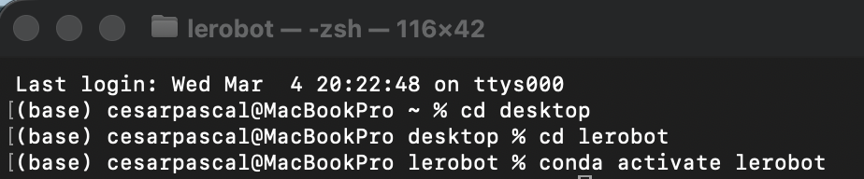
Using LeRobot, an open-source framework for training and controlling humanoid robots, I modified the MuJoCo simulation environment by adding structural elements and deploying multiple Unitree G1 humanoid robots. After configuring the environment and policies, I was able to successfully achieve a stable standing posture for the robots.

Slide 4
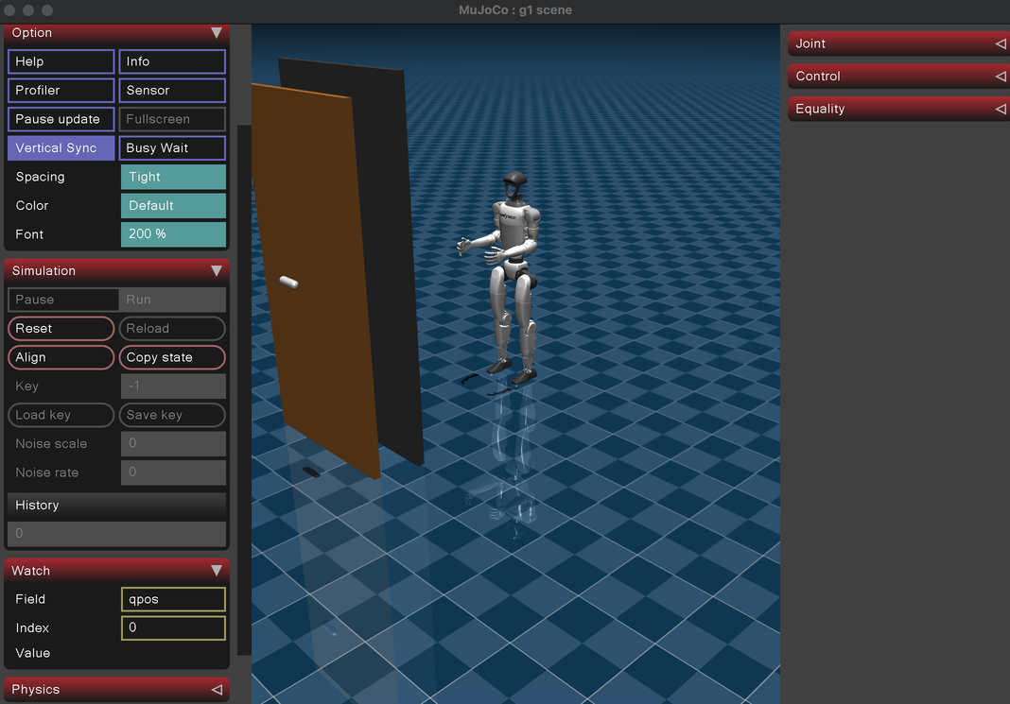
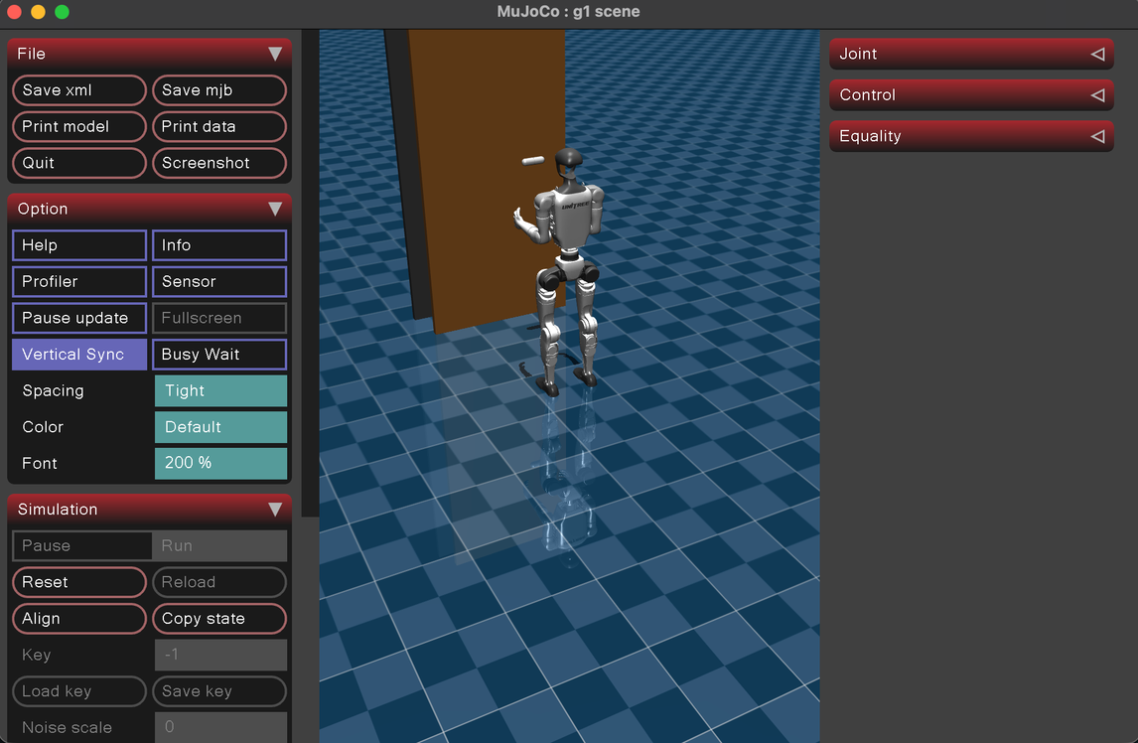

Slide 5
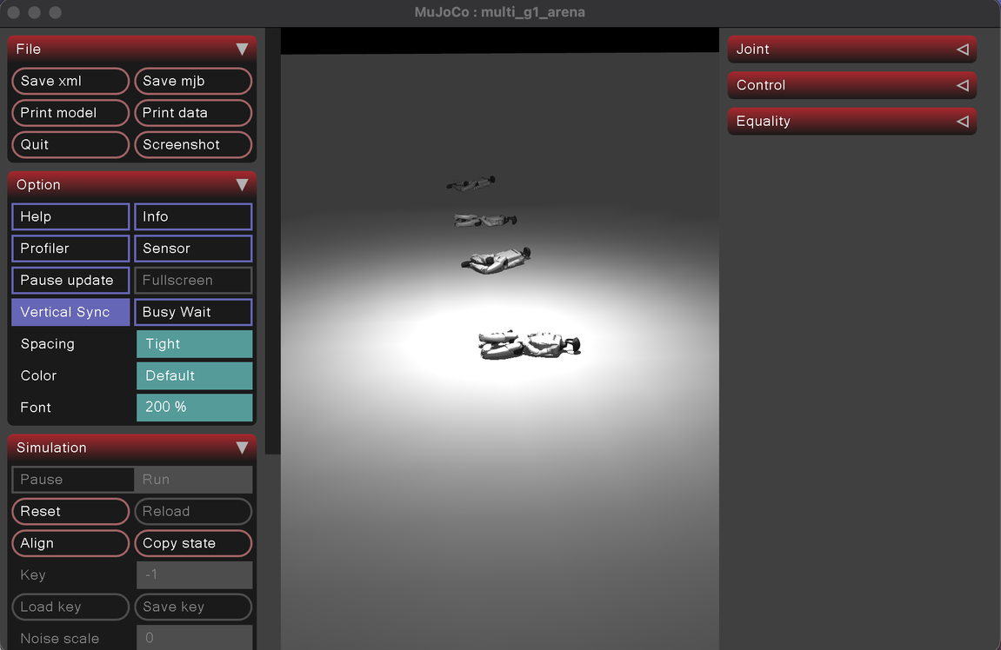
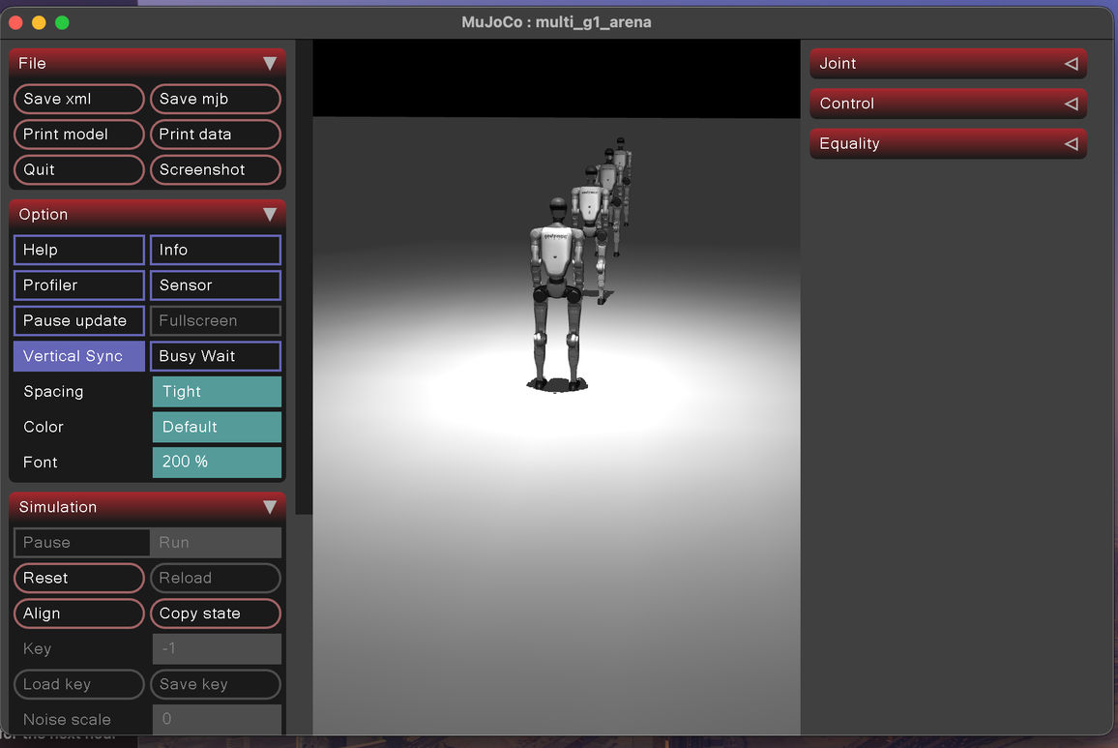

Slide 6
Additionally, I discovered a web platform that allows trained models to be shared through a simple URL, enabling easier distribution of simulations for class demonstrations and collaborative projects.

Slide 7
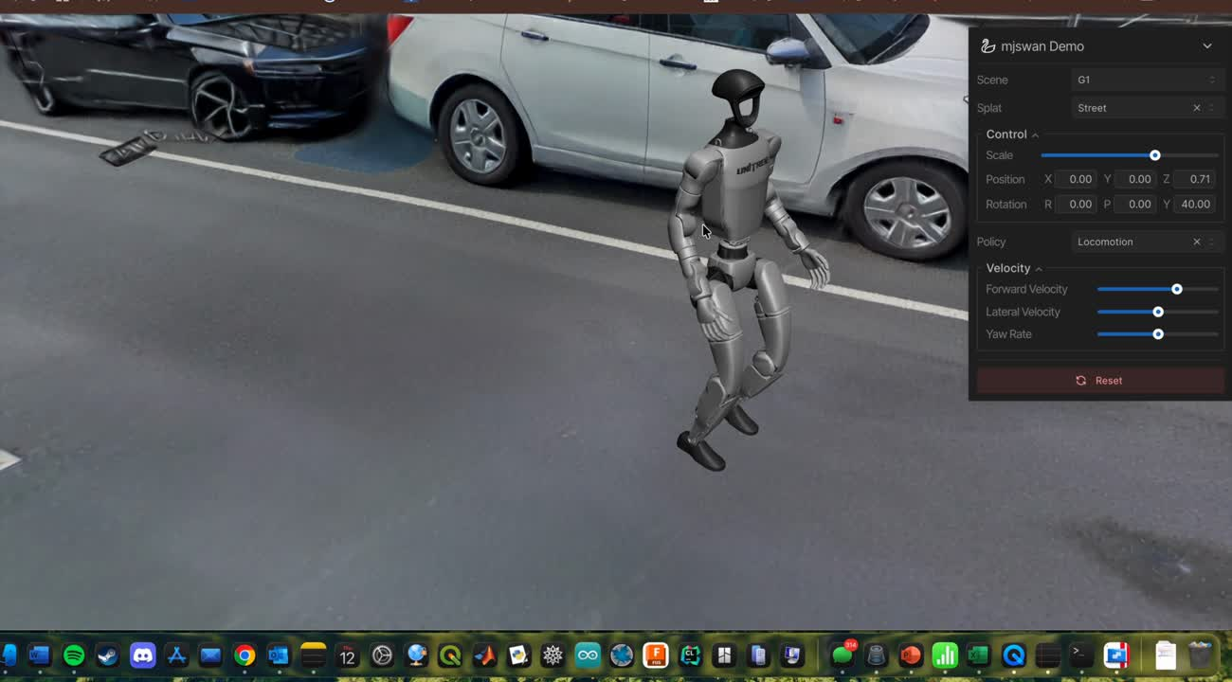
Here is a demostration of it.

Slide 8
I will continue exploring this platform to implement my own model and evaluate how effective it is in practice, with the goal of potentially conducting experiments without requiring local simulation software.

Slide 9
References
LeRobot – Hugging Face Robotics Framework
Hugging Face. LeRobot: Open-source framework for robotics learning and control.
Available: https://github.com/huggingface/lerobot
MJSwan – MuJoCo Web Simulation Platform
M. J. Swang. MJSwan: Web-based platform for sharing and running MuJoCo simulations.
Available: https://ttktjmt.github.io/mjswan/

